Slide 1
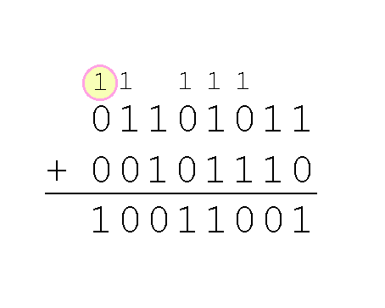
2.4 Binary Addition
28a
We add binary the same way we add decimal.
  Right to left
  Carry to next column
Chapter 3 discusses how to build circuits for this algorithm.
Here is the same calculation in decimal and hex. Make sure you understand how to do them all.
You can check your work by doing binary/hex/decimal conversions.
107 6b
+46 +2e
153 99

Slide 2
2.4 Binary Addition
28b
If we need to carry out from the left-most column, overflow has occurred and the result will be wrong.
In other words, the result of this calculation needed a 9-bit field but only 8 bits were available.
Again, make sure you can do this calculation. Also make sure that you agree with the conversions.
1110 1011
+1010 1110
1001 1001
235
+174
153 wrong!

Slide 3
2.4 Signed Integers
28c
The conversions we have so far presented have involved only positive numbers.
There are three representation systems for signed integers:
  Signed magnitude
  One’s complement
  Two’s complement
We only use the last one. We only look at the first two to show their disadvantages.
For signed numbers, it is essential to know the width of the field, e.g., 8, 16, 32 or 64 bits. Other widths are occasionally used.

Slide 4
2.4 Signed Magnitude
29
The signed magnitude system uses the high-order bit to indicate the sign of a value.
  The high-order bit is the leftmost bit in a byte.
  It is also called the most significant bit (MSB) because in an unsigned number, it represents the largest value.
We will occasionally also use the term LSB, least significant bit, for the rightmost bit, or the bit in the 1’s position.
  This bit has the smallest value.

Slide 5
2.4 Signed Magnitude
30
An 8-bit signed magnitude number contains:
  bit 1: sign bit (leftmost bit)
  bits 2-8: absolute value of the number (7 bits)
For example, in 8-bit signed magnitude,
  3 = 0000 0011
  -3 = 1000 0011
But in 16-bit signed magnitude,
  3 = 0000 0000 0000 0011
  -3 = 1000 0000 0000 0011

Slide 6
2.4 Signed Magnitude
40
Signed magnitude has two significant disadvantages.
1) It requires multiple rules to do arithmetic with signed magnitude numbers.
  How do you calculate 37 + 41?
  What about 37 + (-41)?
2) There are two different reps. for zero, e.g., 0000 0000 and 1000 0000 in an 8-bit system.
  But we want each number to have a unique representation so we can do comparisons.

Slide 7
2.4 Complement Systems
41
For these reasons many computer systems employ complement systems to represent numeric values.
To calculate the one’s complement of a number, we flip each bit.
For example, in 8-bit one’s complement:
  +3 = 0000 0011
  -3 = 1111 1100

Slide 8
2.4 One’s Complement
42
In an 8-bit one’s complement system, the largest absolute value uses 7 bits.
  So the largest number is 0111 1111 = +127
  The smallest number is 1000 0000 = -127
The high-order bit is the sign bit. As in the examples above, it identifies the sign and is not part of the magnitude.
  Positive numbers always have a 0.
  Negative numbers always have a 1.

Slide 9
2.4 One’s Complement
42b
Again, notice the importance of the field width. In 8-bit one’s complement:
  +3 = 0000 0011
  -3 = 1111 1100
In 16-bit one’s complement:
  +3 = 0000 0000 0000 0011
  -3 = 1111 1111 1111 1100
So you can’t left fill a negative number with 0’s to move it to a larger field. You have to left fill negative numbers with 1’s.
  This is called propagating the sign bit.

Slide 10
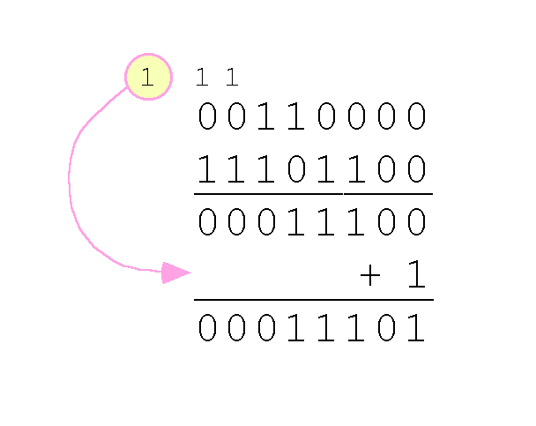
2.4 One’s Complement
43
In one’s complement addition, the carry bit is “carried around” and added to the sum.
Example: Using one’s complement binary arithmetic, find the sum of 48 and -19. The result is 29.
  19 in one’s complement is 0001 0011, so -19 in one’s complement is 1110 1100.

Slide 11
2.4 One’s Complement
43b
Why does end-around carry work?
  Suppose a and b are positive numbers. How would you add a + (-b)?
  You would calculate a-b.
  Now suppose b is represented in one’s complement as (2^{N}-1) - b.
  Then doing unsigned arithmentic would give
  a + (2^{N}-1 - b) = 2^{N}-1 + (a-b).
  But the correct value is 2^{N} + (a-b), so we need to add 1.

Slide 12
2.4 One’s Complement
44
Although end-around carry adds some complexity, one’s complement addition is simpler to implement than signed magnitude.
But it still has the disadvantage of having two different representations for zero:
  0000 0000 = +0
  1111 1111 = -0
Two’s complement solves this problem.

Slide 13
2.4 Two’s Complement
45
To express a value in two’s complement:
  If the number is positive, just convert it to binary.
  If the number is negative, find the one’s complement of the number and then add 1.
Example: decimal to two’s complement
  In 8-bit binary, +3 is: 0000 0011
  So -3 in one’s complement is: 1111 1100
  Adding 1 gives us -3 in two’s complement: 1111 1101.

Slide 14
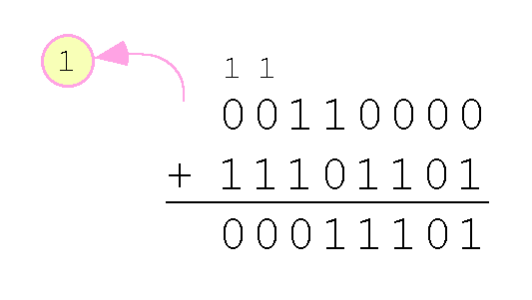
2.4 Two’s Complement
46
With two’s complement arithmetic, we can add binary numbers directly. We discard any carries emitted from the high order bit.
Example: Using two’s complement binary arithmetic, find the sum of 48 and -19. The result is 29.
  19 in one’s complement is: 0001 0011
  so -19 in one’s complement is: 1110 1100
  and -19 in two’s complement is: 1110 1101

